Slide 1
SESSION 2. THE PARENTING STYLE THAT MATTERS MOST: 'AUTHORITATIVE'
Eastwood Heights Public School

Slide 2
Acknowledgment of Country

Slide 3
Welcome
Welcome to our second Investing in Parents session
Focus Team Presenters
Mrs Helen Galat Year 3 Teacher
Ms Lilly Prothero Relieving Deputy Principal
Thank you for attending!
You are all the first teachers of your child/ren, so you play a significant role in shaping your child/ren’s learning and development.

Slide 4
Homework Review
Previous session follow-up- any feedback or sharing of strategies applied
Children move from the preschool stage to the school stage.
In preschool stage, children play and mostly think of themselves and have fun.
At school stage, children have to do schoolwork, get along with others (socialisation), and only play after work is done.
You could refer to these two different stages as the ‘gratification stage’ and the ‘delay of gratification stage’.
Question: Do you think children’s development of the maturity necessary to form social relationships (make friends, work cooperatively, share) and stay engaged in the process of learning, happens naturally? Or do think it is something that children learn and, therefore, have to be taught?

Slide 5
High and Realistic Expectations
In order for children to mature, parents need to communicate high and realistic expectations or standards for schoolwork and social behaviour.
These are modified upwards as children grow older.
Children left to their own devices (and time clock) to decide when they are ready to learn and relate well to others, may find themselves too far behind.

Slide 6
What will we learn in this session?
The importance of parents being authoritative in their approach with their children rather than aggressive or passive.
1
The importance to firmly communicate realistic, high, and clear expectations to their children concerning achievement and behaviour.
2
Setting home rules and consequences can help them help their children achieve high standards and make good behavioural choices.
3
The importance of being consistent and
persistent in enforcing rules.
4
The importance of accepting their children
when their children do not live up to ’parents’ expectations concerning achievement and behaviour.
5
The importance of teaching children to not put themselves down when they have not achieved in their schoolwork or have behaved poorly. Parents will also learn how important it is to teach their children to accept themselves, while working to improve their achievement and behaviour.
6

Slide 7
Aggressive, Passive and Authoritative Parenting
Aggressive parenting
Passive parenting
Authoritative parenting
Involves setting poorly defined rules (or no rules at all), allowing children to decide whether they will follow the rules. Passive parents fail to follow through with penalties when children break the rules.
Involves setting reasonable rules, consistently and persistently enforcing them. Parent offers appropriate rewards and penalties when children follow or break the rules, and is flexible when the rules need to change.
Involves setting unreasonable rules, strictly enforcing rules with harsh penalties, and blaming or criticising children when they break rules.

Slide 8
Aggressive parenting
Aggressive parenting
Verbal behaviour: The use of emotionally loaded, accusing words and statements, that demand a parent gets what they want. Statements convey parent superiority and child’s inferiority. Parent blames and criticises a child for what he or she has or has not done. Parent threatens and makes choices for the child.
Non verbal behaviour: Conveys an air of superiority. Tone of voice is sarcastic, tense, loud, icy, and authoritarian. Eyes are narrowed and cold. Parent stands with hands on hips, chest extended, and fist and jaw clenched. Parent appears tense.

Slide 9
Passive parenting
Verbal behaviour: Parent never really says what they would like to say. Parent always agrees with what the child wants. Parent expresses themself in a very rambling style. Parent uses apologetic words. Child makes choices for parent.
Non verbal behaviour: Parent expresses themselves faintheartedly. Voice is quiet and shaky. In conflict situations with a child, parent does not look the child in the eye. Parent looks downward, leans forward, and stands apart from the child.
Passive parenting

Slide 10
Authoritative parenting
Verbal behaviour: Parent states clearly and directly to the child what they honestly feel, think and want, as well as what they would like to have occur. Parent sticks to the facts and makes their own choices.
Non verbal behaviour: In conflict situations with the child, parent employs a confident, warm, yet firm tone of voice. Parent maintains good eye contact, reflects openness. Parent’s posture and expression are relaxed, and parent uses hands naturally.
Authoritative parenting

Slide 11
Parenting Styles: Senario
Your child is to complete their homework immediately after school. You come home from work one day and discover that said child hasn’t even started her homework because she wanted to watch an after-school special that will be televised only once and can’t be viewed electronically at a later date.
Think about your parenting style-
What would you do?
What would you say?
Share with the group

Slide 12
Communicate High and Realistic Expectations
Children who perform to their potential in school and seem to make responsible choices concerning their behaviour have parents who communicate clear and high expectations for achievement and behaviour. These expectations are firmly enforced with rules that have consequences.
Rules and consequences
If parents send the message that they believe in their children’s ability to achieve and expect them to do their best in their schoolwork and other areas of their lives (e.g. music, art, sport), children are more likely than not to rise to the occasion and achieve.
Emphasise that the expectations parents communicate to their children about what they should be able to accomplish in their schoolwork and other activities, must be realistic and in line with the child’s interests and abilities. For example, it can be quite devastating for a younger child to be held to the same high academic standard as an older sibling. This is especially so when the younger sibling has a lesser academic ability. Comment on whether the father in the illustrations is communicating a realistic expectation, or whether he seems to be expecting too much of his daughter.
Doing their best
Realistic

Slide 13
Define the word ‘success’

Slide 14
Define the word ‘success’
Success means achieving a goal you’ve set out to accomplish through hard work.
It does not mean getting top marks in all subjects or being the best.
Some parents - with the best of intentions - can create such a high level of expectation in the mind of a child that the child may, in time, give up trying or believe he or she will never be able to get there.
It is important to communicate this definition of success to your children, and to them to get excited about being successful.

Slide 15
Communicate High and Realistic Expectations
Children need guidelines for doing the best they can in their schoolwork, so too, do they need their parents to communicate what constitutes a high standard for the type of behaviour that is expected of them in relating to others (e.g. peers, parents, teachers).
Discussion:
What do you say to your children to communicate your expectations for appropriate behaviour?

Slide 16
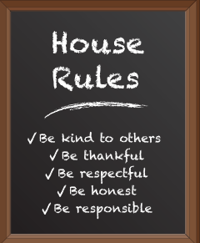
Set Effective Rules
When children are young, parents must set the rules.
However, as children grow older, parents must allow them to have a voice in establishing the rules. Whatever the age of their children, parents must take time to discuss household rules with them. This will ensure that children understand parental expectations, as well as the rewards and consequences of following or not following the rules.
Put your possessions in their proper place.
Treat other people’s property with respect.
Treat other people with respect.
Resolve disagreements without yelling or fighting.
Work hard on homework to do your best job.
Keep your word.
Be on time.
Make sure you have everything you need before leaving
the house in the morning.
Be home when you say you will be home

Slide 17
Guidelines for Setting Rules that Work
Effective household rules outline several important responsibilities for children.
They also specify appropriate and inappropriate behaviour. While parents have the authority to decide what is best for their children and, therefore, to set household rules as children grow older, parents must be prepared to discuss their reasons for establishing particular rules
Parents should be flexible in terms of how the children interpret them. Controlling behaviour through strict enforcement of the rules is not the point here.
The point is teaching children to respect rules.
Decide upon a few important rules.
Discuss the reasons for these rules with your child.
Involve your child in discussing the limits of the rules, as well as fair and reasonable consequences for breaking the rules.
Praise your child when he or she follows the rules.
Consistently, assertively, and calmly follow through with the consequences when the rules are broken.
Change the rules and expectations as your child grows up.

Slide 18
Be Consistent and Persistent
Enforcement is the action of ensuring that children follow rules by providing appropriate rewards and consequences. If rules are to be effective, parents must consistently and persistently follow through with the agreed rewards and consequences. To this end, parents must not set rules they are not prepared to enforce.
Consistent and persistent rule enforcement by both parents not only teaches children that they will achieve better results when they stick to the rules, but also that their parents appreciate their cooperation and effort.
Indicate that the most common form of recognition for following rules is praise

Slide 19
Acceptance
What happened to the girl?
How did getting a D make her feel?
What do you think the girl was thinking that made her feel so very angry with herself and down?
What could be the result for the girl if she continues to get unsatisfactory results in some of her schoolwork and if she continues to feel extremely down? Could she begin to get depressed or give up?
What is the reaction of the girl’s father to her not achieving high expectations in her schoolwork? How did he handle himself emotionally?
What is the reaction of the girl’s father to her not achieving high expectations in her schoolwork? How did he handle himself emotionally?
What could be the impact on the girl if her father started yelling and being quite upset about her lack of achievement?
What does the father mean when he says: “Remember, one bad piece of fruit doesn’t make the whole barrel rotten”?
Parents need to be careful about not expecting too much of their children in terms of their school performance. Establish agreement that staying calm with children and communicating an Accepting Myself way of thinking can be of enormous benefit to the social-emotional wellbeing of children especially those children who are extremely sensitive to low self esteem.

Slide 20
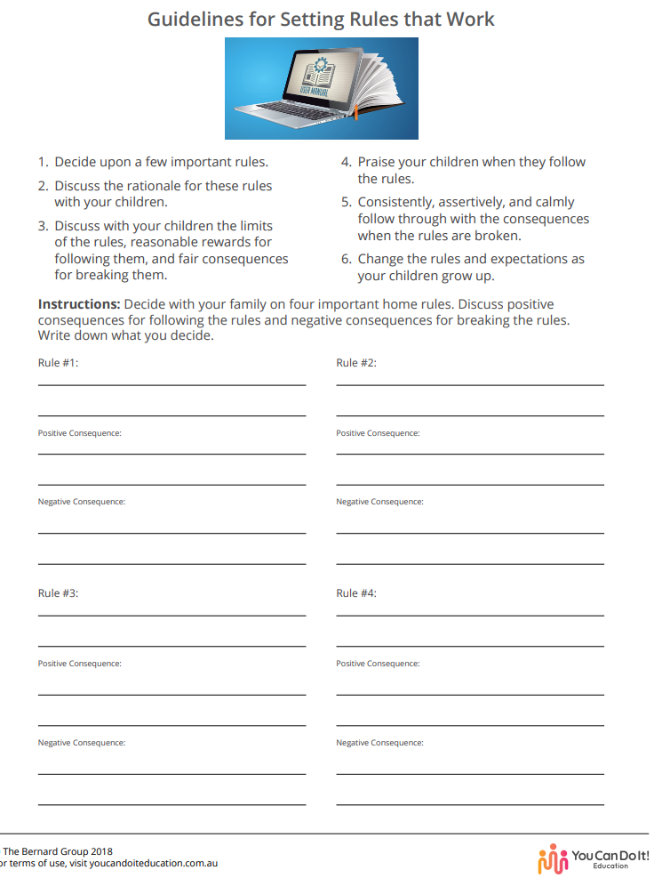
Parent Implementation of Learnings at Home
Come up with a list of home rules and consequences during the coming week to list on the Session 2. Handout 1. Guidelines for Setting Rules that Work.
Discuss important household rules with your family, as well as the rewards of following, and negative consequences of breaking rules.
Work on communicating high, but realistic expectations for your children’s school achievement, and to adopt and communicate an attitude of acceptance.

Slide 21
Thank you for attending !
SESSION 3. AVOID COMMON MISTAKES THAT PARENTS CAN MAKE - (INEFFECTIVE PARENTING)
Term 2, Week 2, Tuesday 3 May 2022
Questions?
Feedback?

