Slide 1

SESSION 1.
PARENTING TODAY:
WHAT DO YOU WANT FOR YOUR CHILDREN?
You Can Do It Education: introducing the goals of the Investing in Parents program

Slide 2
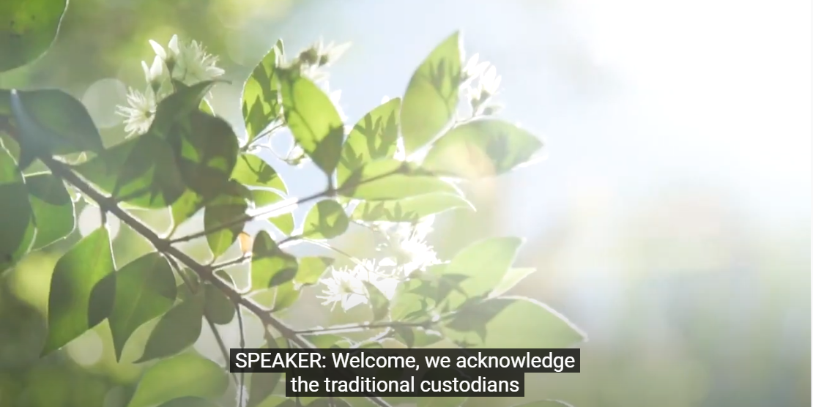
Acknowledgement of Country
Notes:
Definition of antiquity
1 : ancient times especially : those before the Middle Ages a town that dates from antiquity. 2 : the quality of being ancient a castle of great antiquity. 3 antiquities plural. a : relics or monuments (such as coins, statues, or buildings) of ancient times a museum of Greek antiquities.

Slide 3
Participants agree to arrive for training sessions on time.
During Zoom sessions please stay muted unless speaking and have your camera on.
Participants agree to respect what other participants say. All parents agree to do whatever they can to make others feel accepted and valued.
No one will take control of discussions or team activities.
When participants speak, other members agree to listen with positive attention.
Participants agree to participate in group discussions and activities as much as possible.
Participants agree to volunteer for and share work rather than allowing only a few of the participants to do all the work.
Participants agree not to monopolise sessions with questions about their own children, including how to get them to stop misbehaving.

Slide 4

What do Parents want for their Children?
Discussion:
Most important want for your children?

Slide 5
What you will Learn in the Session?
We will become more aware of two goals that most parents have for their children:
achieving to their potential (doing the best they can) and
positive social-emotional wellbeing.
the meaning of educational underachievement and how to recognise signs of underachievement in their children
the meaning of social-emotional wellbeing and how to recognise its existence in their children.
the important role parents play in influencing their children’s achievement and social-emotional wellbeing.
how important it is for parents to believe that they have the skills and knowledge necessary to exert a positive influence on their children.
good parenting practices that support children’s social-emotional wellbeing and achievement.
learn about one of the major influences parents have over their children: positive reinforcement.

Slide 6

What is Educational Underachievement?
... a child’s performance as evidenced by class assessment and reporting—is lower than we would predict based on the child’s age and ability.
... a child appears to have a discrepancy between his/her ability or aptitude and his/her achievement.
... a child has high ability and lower achievement.

Slide 7

Educational Underachievement
:A Common Problem
• 30% to 40% of all students underachieve
• Boys who underachieve out number girls who
underachieve by a ratio of 7:3
• Boys are more likely than girls to underachieve
in reading, writing and spelling
• Underachievement increases as children grow
older and generally begins in the last two years
of primary school

Slide 8

Examples of Things to Reverse Underachievement
Child encouraged to engage in extra curricular activity • Parents can talk with the child to discover his/her interests and encourage engagement. • Child can be enrolled in a club, class or other group. • Time needs to be scheduled in the child’s day for this interest.
Parent attitude • Parents need to make sure they continue to be supportive of their child in seeking success. • Parents need to love their child in spite of inappropriate behaviour, and not be too concerned or critical of their child’s mistakes in their schoolwork.
Child takes a challenging class • This suggestion is for ‘gifted and talented’ children who are underachieving. • Parents can enrol their child in an after school program or class for a subject in which the child shows special interest.
Child knows the long-term goals he or she wants to achieve (for older children) • Parents need to schedule a goal-setting session with their child. • Parents can help the child see that doing boring, unexciting work today acts as a stepping stone to reaching long term goals.
Self confidence • Parents need to know that success breeds success. An underachieving child is likely to be discouraged. • At school and at home, a child needs opportunities to be successful and to receive acknowledgment. • Success leads to a child thinking, “If I can do that, I can achieve this.”

Slide 9
Young People’s
Social-Emotional Wellbeing
Presence of the positive
Absence of negative
social-emotional outcomes
Young person generally appears to...
be happy
have positive self esteem
relate positively to family • get along with classmates, including those who are different
feel safe and free from physical harm
relate positively to family
make responsible choices to stay out of trouble
Young person generally appears not to...
have significant periods of time when he/she feels down
lose his/her temper
act impulsively
physically bully or verbally tease other students • engage in unhealthy behaviour (alcohol, drugs, sex)
hate being at school
worry too much about what others think of him/her
be very stressed
be lonely or a loner
underachieve in one or more areas of schoolwork
act dishonestly (lie, cheat or steal)
get into trouble a lot
have his/her feelings easily hurt

Slide 10

Positive Reinforcement
Instructions:
Catch your child in the act of doing homework, relating well to a family member, or doing a chore, and say:
“You are trying very hard.”
“Good job.”
“That effort will help make you a success.”
“You are getting along well.”
“Doing chores without me having to always
remind you shows me how responsible you
are.”
“Well done!”

Slide 11

Good Parenting Practices that Support Children’s Social-Emotional Wellbeing and Achievement
Good practice –
Use supportive motivational methods
Good practice –
Develop a positive relationship with your children
Good practice –
Provide a range of activities that accommodate your children’s interests
Good practice –
Firmly communicate to your children high and clear expectations for achievement and behaviour
Good practice – Show interest/involvement in your children’s education
Good practice –
Provide your children with
responsibility and opportunities for decision making
Good practice –
Encourage the development of your children’s social-emotional competence (confidence, persistence, organisation, getting along, resilience, social responsibility)

Slide 12

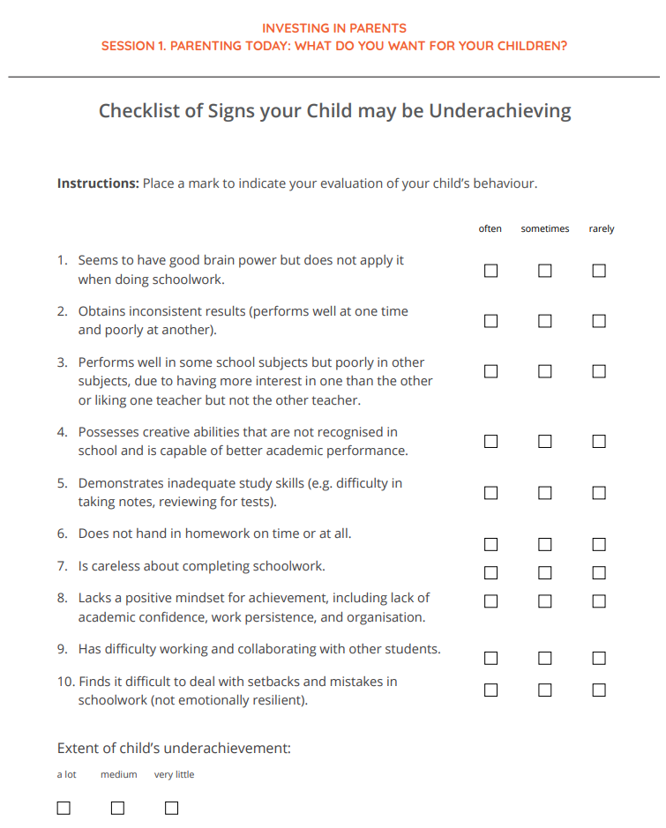

Slide 13
Parent/ Carers you may like to
- keep a parenting journal. Some of you may want to keep a handwritten journal, others may wish to use an electronic device.
- write about your experiences with your child/ren or insights gained from this session. You could record plans of action, descriptions of interactions with your children, or the outcome of using particular parenting techniques.
- During the coming week, focus on one specific behaviour of your child that they would like to see increased. Use positive reinforcement whenever your child/ren engage in the behaviour and ignore those times when he or she does not.
- Towards the end of the week, note in their journal their observations of their use of positive reinforcement and its effect on their child’s behaviour.
You can mention the number of sessions and topics that will be covered in this parent education program.
Parent Implementation of Learnings at Home

Slide 14

Partnership
Parents Make a Big Difference

