Slide 1
Eastwood Heights Public school
Session 5: Develop positive relationships with your children

Slide 2
Acknowledgement of country

Slide 3
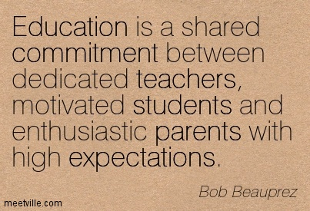
welcome
Mrs Shirley Ratinac – Science RFF Teacher
Mrs Helen Galati – Year 3 Teacher
Ms Lilly Prothero – Relieving Deputy Principal

Slide 4
Review and catch-up
Stories of resilience
Practical stress management tips
New approaches?

Slide 5
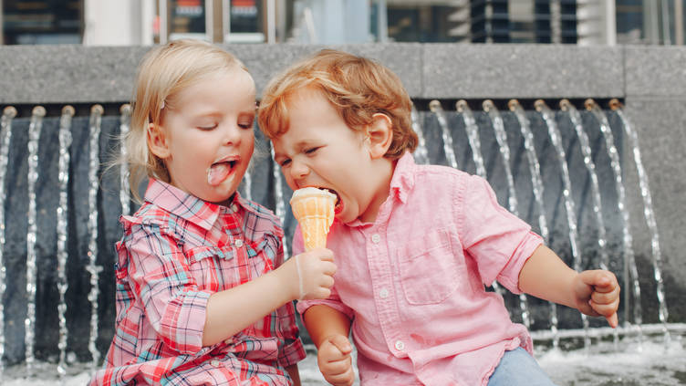
Sharing experiences

Slide 6
Habits of communication
How many of you have experienced a parent or colleague who had a negative attitude towards you and with whom you had a negative relationship?
Are you inclined to listen to, or be motivated by, that person’s advice?

Slide 7
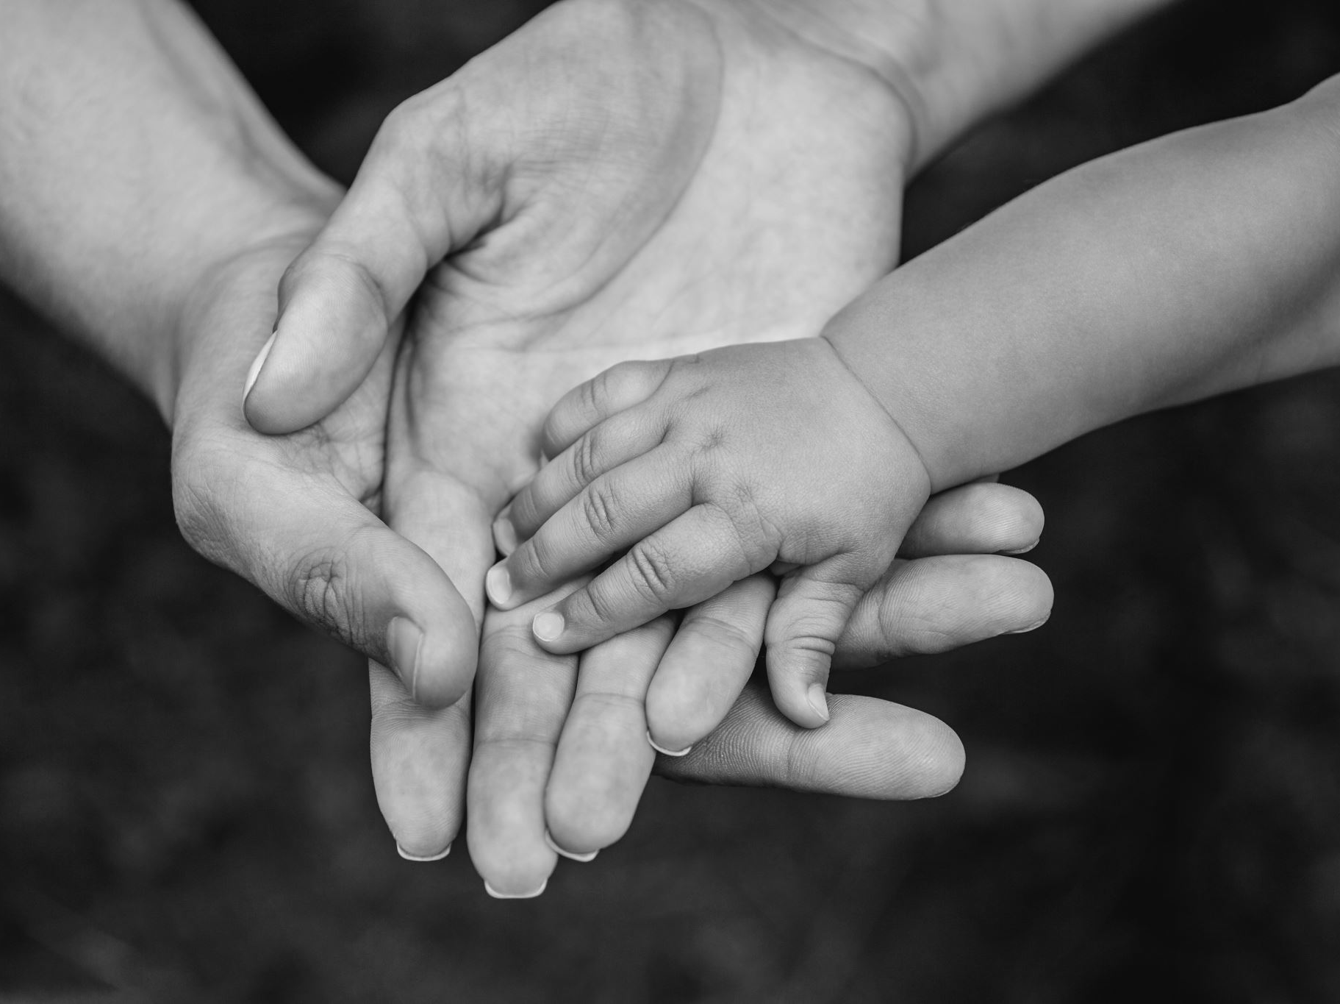
habits of communication
How likely is it for a parent to be able to help motivate a child or build a child’s sense of happiness and confidence if the relationship is one in which communication is often heated and where affection is seldom expressed?

Slide 8
What you will learn in this session
Participants will be able to recognise the fundamental importance of working on developing a positive relationship with their children.
Participants will be able to list a number of common practices parents use to build positive relationships with their children.
Participants will be able to state the extreme importance of expressing love and affection to their children.
Participants will be able to state the importance of listening to their children and be able to utilise the active listening technique.
Participants will be able to recognise different forms of support that children view as essential in building a positive parent-child relationship.

Slide 9
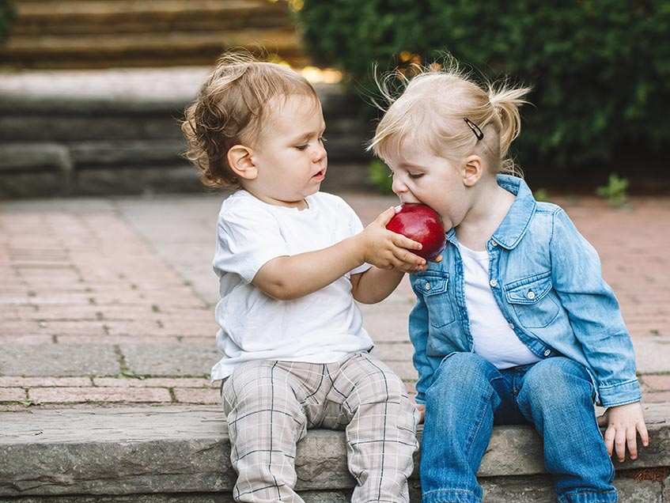
Sharing is caring
What kinds of things do you do with your children that you believe helps to build a positive relationship?

Slide 10
Some helpful reminders
Disciplining without anger and not using a negative tone of voice
Expressing love and affection
Listening to a child without offering advice
Being supportive
Showing interest and becoming involved in what children are doing

Slide 11
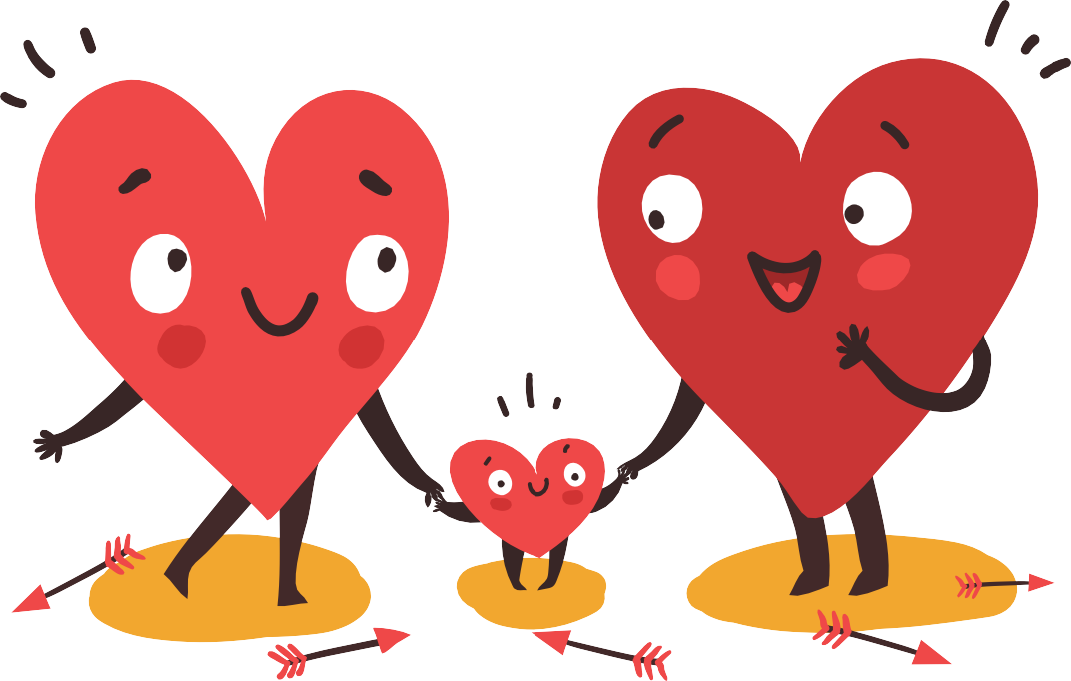
love
Child vs behaviour
Consistency

Slide 12
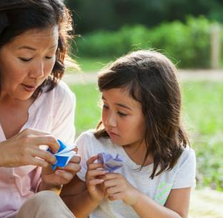
Share some more….
When is it difficult to express love to your children? Why?
How do you generally express your love for your children?
How often do you show affection for your children?

Slide 13
listen
Give opportunity to talk through a situation or problem.
Validate their feelings and demonstrate respect.
Just listen.

Slide 14
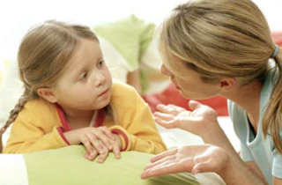
Your turn …
Think about a problem your child might be having recently.
How would you describe that problem?
Would your child describe the problem in the same way?

Slide 15
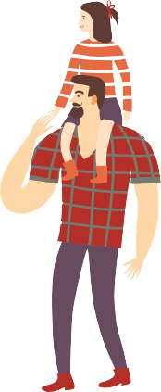
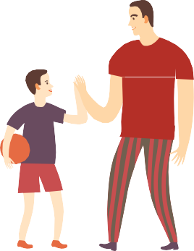
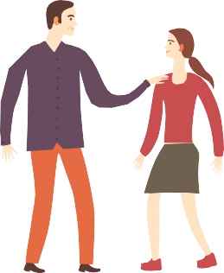
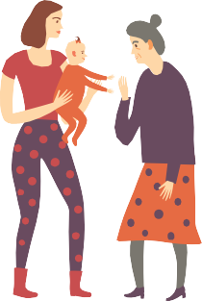
Be supportive
Physical affection
Sustained physical contact
Companionship
Availability of parents when needed.

Slide 16
INVESTING IN PARENTS
SESSION 5. DEVELOP POSITIVE RELATIONSHIPS WITH YOUR CHILDREN
Showing Support
Physical affection (e.g. hugs, kisses)
Sustained physical contact (e.g. sitting together, walking arm in arm)
Companionship (e.g. time shared together)
Availability of the parents when needed (e.g. listening)
Describe one instance of each of the above types of supportive affection you have shown your
children in the last month.
Physical affection:
Sustained physical contact:
Companionship:
Availability:
What type(s) of support and affection are you most comfortable expressing to your children?
Why?
What can you do to ensure you express to your children the type of support they need?

Slide 17
implementation
Practise some active listening – no interruptions, no advice or comments. Just repeat back what you hear your child saying.
Use some of the strategies suggested to strengthen your relationship with one or more of your children.

Slide 18
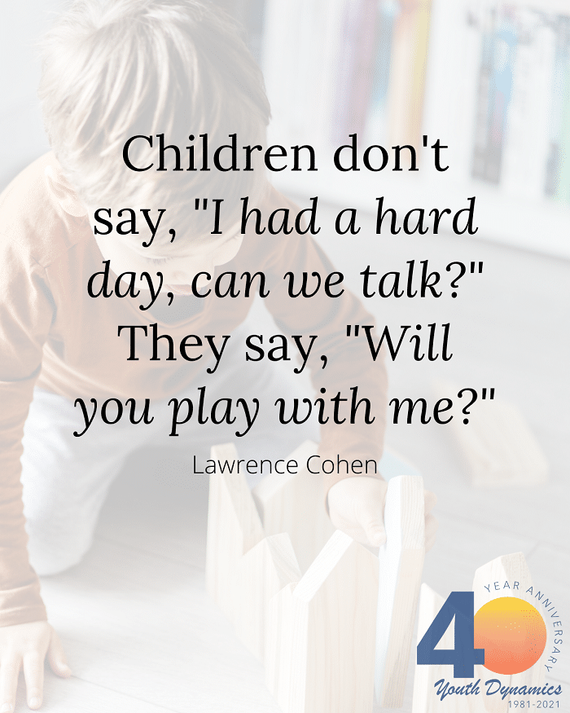
Thank you for attending!

