Slide 1
Investing in Parents
SESSION 3.
AVOID COMMON MISTAKES THAT PARENTS CAN MAKE
- (INEFFECTIVE PARENTING)

Slide 2
Acknowledgment of Country

Slide 3
Welcome! Presenter-Rebecca Sammes: Early Stage 1 Teacher Co-Host-Lilly Prothero: Relieving Deputy Principal
Parents are the first teachers of their children and play a significant role in shaping their children’s learning and development.
Laying the foundations for children’s achievement and happiness is one of the most challenging and difficult jobs imaginable. It’s easy for parents to fall into unhelpful habits. The five foundations of good parenting covered in this session have more impact when parents become aware and change aspects of their parenting that are not so helpful.

Slide 4
What you will learn in this session:
How ineffective parenting styles negatively impact on children’s motivation, achievement and social-emotional wellbeing.
Reflect on own parenting styles and how they contribute to their children’s achievement, motivational difficulties, and social emotional problems.

Slide 5
Questions to ponder during the session
What parenting practices can inhibit a child’s desire to achieve and/or lead to a child developing low self esteem or extreme defiance?
What parenting practices do you use that might interfere with your child’s achievement and/or happiness?
How can you change one of your own less effective parenting habits immediately?

Slide 6
Parenting Styles Contributing to Lower Motivation, Under Achievement, and Negative Social-Emotional Wellbeing
Although many parents do not believe they can make a difference in their children’s lives, especially as children grow older, this is simply not true. For better or worse, the way we parent our children affects their level of achievement and happiness more than any other factor.

Slide 7
The authoritative parenting style that can be found in Session 2 of Investing in Parents has proven most effective for enhancing children’s development.
However, the topics in this session are helpful to examine and understand the parenting styles most likely to contribute to underachievement and poor social emotional wellbeing. By looking at these less effective parenting styles, parents have the opportunity to become aware of their own parenting strategies and the reasons why some strategies do not work.
No one uses ineffective parenting practices intentionally, and that we often simply parent the way we were parented. See if you can recognise any of your own ineffective parenting habits in the following descriptions. You can then begin to make positive changes that will affect the relationship with their children and, therefore, your children’s ability to achieve and be happy.

Slide 8
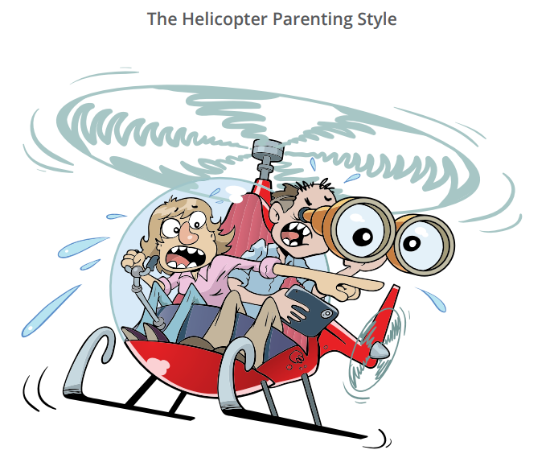
The Helicopter Parenting Style
Overprotective parents hover over their children. These parents assume too much responsibility for what happens to their children. They try to ensure that nothing goes wrong for them, attempt to guarantee that they are never frustrated, and try to rescue them from difficulty.
Some parents may even complete their children’s assignments to ensure they (the parents) don’t feel uncomfortable seeing their children turn in work that is not up to standard.
Consequences for children: anxiety, overdependence on parents and teachers, fear of making mistakes, sensation sensitivity, avoidance of competition, unwillingness to take responsibility for schoolwork and behaviour, lack of self-confidence and resilience.
Remedy: Parents who use an overprotective parenting style can change. They can place the responsibility for schoolwork and homework on their children’s shoulders, teach their children the importance of tackling difficult assignments, and remind themselves that their children can tolerate handing in work that isn’t 100 per cent, or receive negative comments from the teacher.

Slide 9
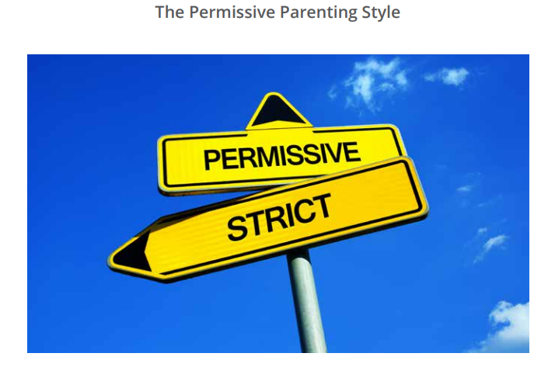
The Permissive Parenting
This style characterises parents who may be reacting to their own strict upbringing. Permissive parents set few and inconsistently enforced rules. They may believe that rules stifle creativity.
Consequences for children: lack of self-discipline, unwillingness to perform hard work, development of ‘frustration phobia’, defiance, and abuse of personal power and authority.
Remedy: Parents who use this style can change. They can create a more structured home environment, and establish rules. These rules need to clearly spell out right from wrong, appropriate and inappropriate behaviour, expectations for schoolwork, and the rewards and consequences of abiding by or breaking the rules. Parents must commit to firmly enforcing the rules they establish.

Slide 10
The Powerless Parenting Style
Parents who use this style can feel helpless in influencing their children’s behaviour. This may be because they fear their children’s anger and rejection, or because they lack confidence in themselves in asserting their authority.
Consequences for children: a belief that they can do whatever they please whenever they please, misbehave, lack motivation, and achieve poorly in subjects they consider to be boring.
Remedy: Parents who use this style can change. They can create a more structured home environment by establishing rules, firmly enforce these rules, and assert their parental authority.

Slide 11
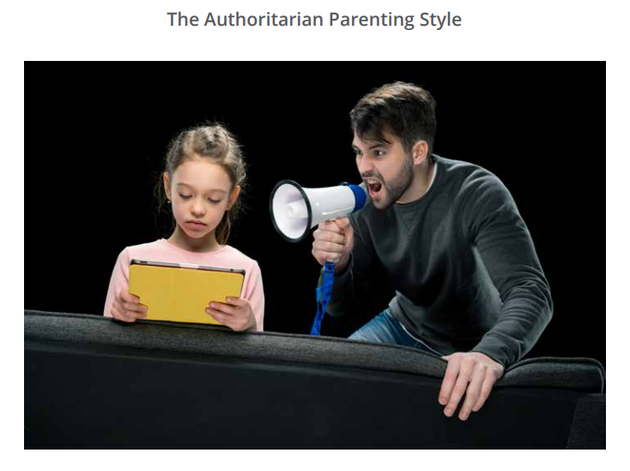
The Authoritarian Parenting Style
Authoritarian parents demand control and obedience of their children. They set too many rules, enforce the rules too strictly, and deliver harsh and severe punishments.
These parents view themselves as ‘the boss’, frequently discipline with anger, say humiliating things to their children, withdraw love as punishment for disobedience, and use aggressive, nonverbal communication.
Consequences for children: feelings of inadequacy, anxiety about winning the love and approval of their parents, and fear of not living up to parental expectations. Children may rebel, use power struggles or passive-aggressive behaviours (e.g. intentional underachievement) to get back at parents, or play a harsher parent against a more protective parent.
Remedy: Parents who employ this style can change. They can treat their children with love and respect, establish reasonable expectations of them, and allow children to have a voice in establishing household rules, rewards, and consequences.

Slide 12
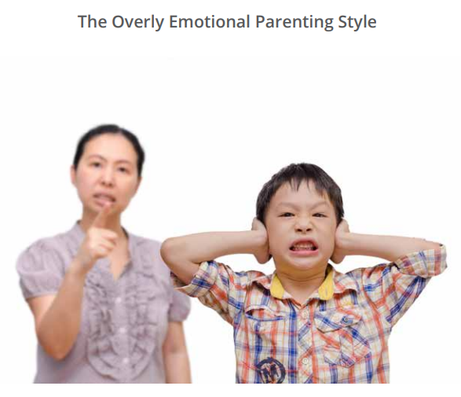
The Overly Emotional Parenting Style
Overly emotional parents believe that getting extremely upset solves problems effectively. When confronted with the child’s problems, these parents can become overly upset (e.g. enraged, panicked, or depressed), as opposed to annoyed, concerned, or disappointed. They fail to think through solutions effectively. They repeat past ineffective responses, making it extremely difficult to change their children’s behaviour. The emotional upset these parents display as a result of their children’s behaviour provides the children with secondary gain - a feeling that they are not only getting away with something, but that they also have the power to control their parents’ emotions.
Consequences for children: defiance and manipulative behaviour. Children learn that their failure to complete schoolwork and lack of academic success causes their parents to become very upset. Because they come to enjoy pushing their parents’ emotional buttons, the children have great difficulty overcoming the problems that prevent them from working effectively and achieving.
Remedy: Parents who use this style can change. They can physically remove themselves from their children when they feel their emotions rising to extremes, practise relaxation exercises to calm their extreme emotions, and master stress management techniques.

Slide 13
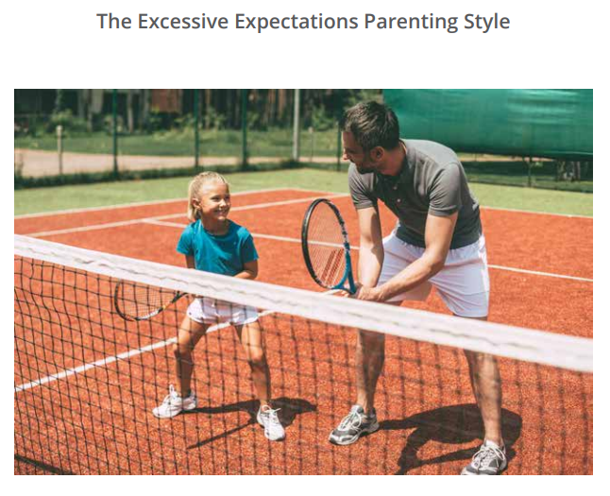
The Excessive Expectations Parenting Style
These parents employ nagging (e.g. “Come on, you can do better than that.”), express dissatisfaction with their children’s school accomplishments, place much pressures on their children, and compare them with siblings, family members and friends who achieve at a higher level.
Consequences for children: A belief that they will never be able to please their parents, feelings of anger and resentment toward parents, and defiance. These children underachieve because they’ve given up on ever meeting their parents’ expectations.
Remedy: Parents who use this style can change. They can establish more realistic expectations of their children⎼ guided by their children’s aptitudes, interests, and personality style rather than expecting ideals and standards that may be unreasonable for individual children.

Slide 14
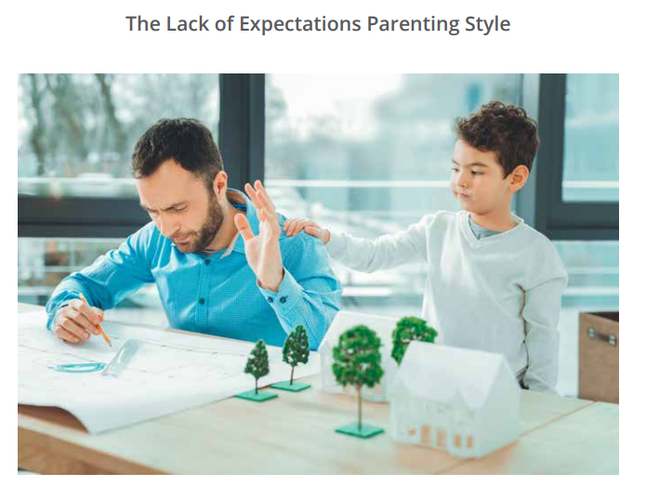
The Lack of Expectations Parenting Style
These parents do not expect their children to achieve very much at school. These parents fail to support or reinforce their children’s educational efforts, and spend little time on school readiness activities (e.g. reading aloud to the child).
Consequences for children: The belief that school is not important, and a failure to learn the value of education for future success and satisfaction in life.
Remedy: parents who use this style can change. They can communicate realistic high academic expectations to their children, stress the importance of a good education, and get more involved in their children’s education.

Slide 15
The Unsupportive of School Parenting Style
Parents in this category openly criticise the school and teachers in front of their children, and often do not support the school’s expectations of their children.
Consequences for children: Lack of respect for teachers, not taking schoolwork seriously, and eventually losing all interest in school.
Remedy: Parents who employ this style can change. They can communicate respect for teachers and talk directly with teachers about school-related objections or concerns.

Slide 16
Parent Reflection Form
* Completed before the session

Slide 17
Handout 1. Breakout Rooms
Parent Reflection Form:
Know Your Parenting Styles

Slide 18
Know Your Parenting Style: Group Feedback

Slide 19
Implementation of Learnings at Home
Identify one of the immediate actions from the group list for changing your style of ineffective parenting. Practise this alternate action as you interact with their children throughout the week. In order to replace the ineffective habit with a new alternative, parents must remain aware of their tendency to rely on the ineffective response. Make a conscious effort to use the new action instead.
Record in your journals, insights that have gained from this interaction with your children. Make sure you note your children’s responses to this new parenting solution.

Slide 20
SESSION 4. PARENT STRESS MANAGEMENT AND RESILIENCE
This session will help parents change an overly emotional parenting style. It will also help all participants manage the inevitable high emotional stress of being a parent.
Date: Week 4 -Tuesday 17 May
Presenter; Mr Joshua Gale

