Slide 1
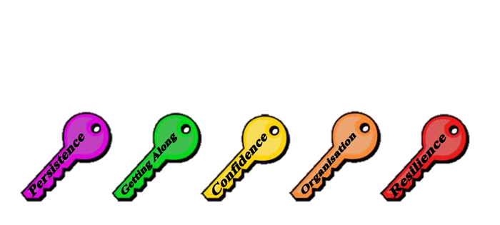
You Can Do It!
Parent modules 5 & 6
You are the key to your own and your child’s success

Slide 2
YCDI @ EHPS
Classroom - lessons
Classroom - reward system
Playground
Parent Modules – 5 + 6

Slide 3
Supporting behaviour and achievement
Module 5

Slide 4
Supporting behaviour and achievement
Parenting Styles
Setting High Expectations
Setting Effective Rules
Acceptance

Slide 5
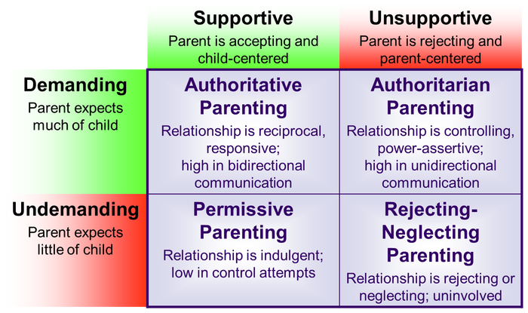
Parenting styles

Slide 6
PARENTING STYLES
AGGRESSIVE –unreasonable rules, strictly enforcing – no exceptions
Blaming, emotional, enforce superiority, threaten, make choices for them, tense
PASSIVE – unclear rules (or none), no consequences Never speak your mind, always agree with child, apologetic, child makes choices for you, quiet / shaky
AUTHORITATIVE - reasonable rules, consistent follow through, flexibility when required, reasonable reward or penalties
Clear, honest and direct, explain reasoning, stick to your choices confident, warm yet firm, eye contact and open body language

Slide 7
Roleplay Child – Aggressive – passive - authoritative
Your children are to complete their homework
immediately after school. You come home from
work one day and discover that your child hasn’t
even started her homework because she wanted
to watch an after-school special that airs only
once a year.

Slide 8
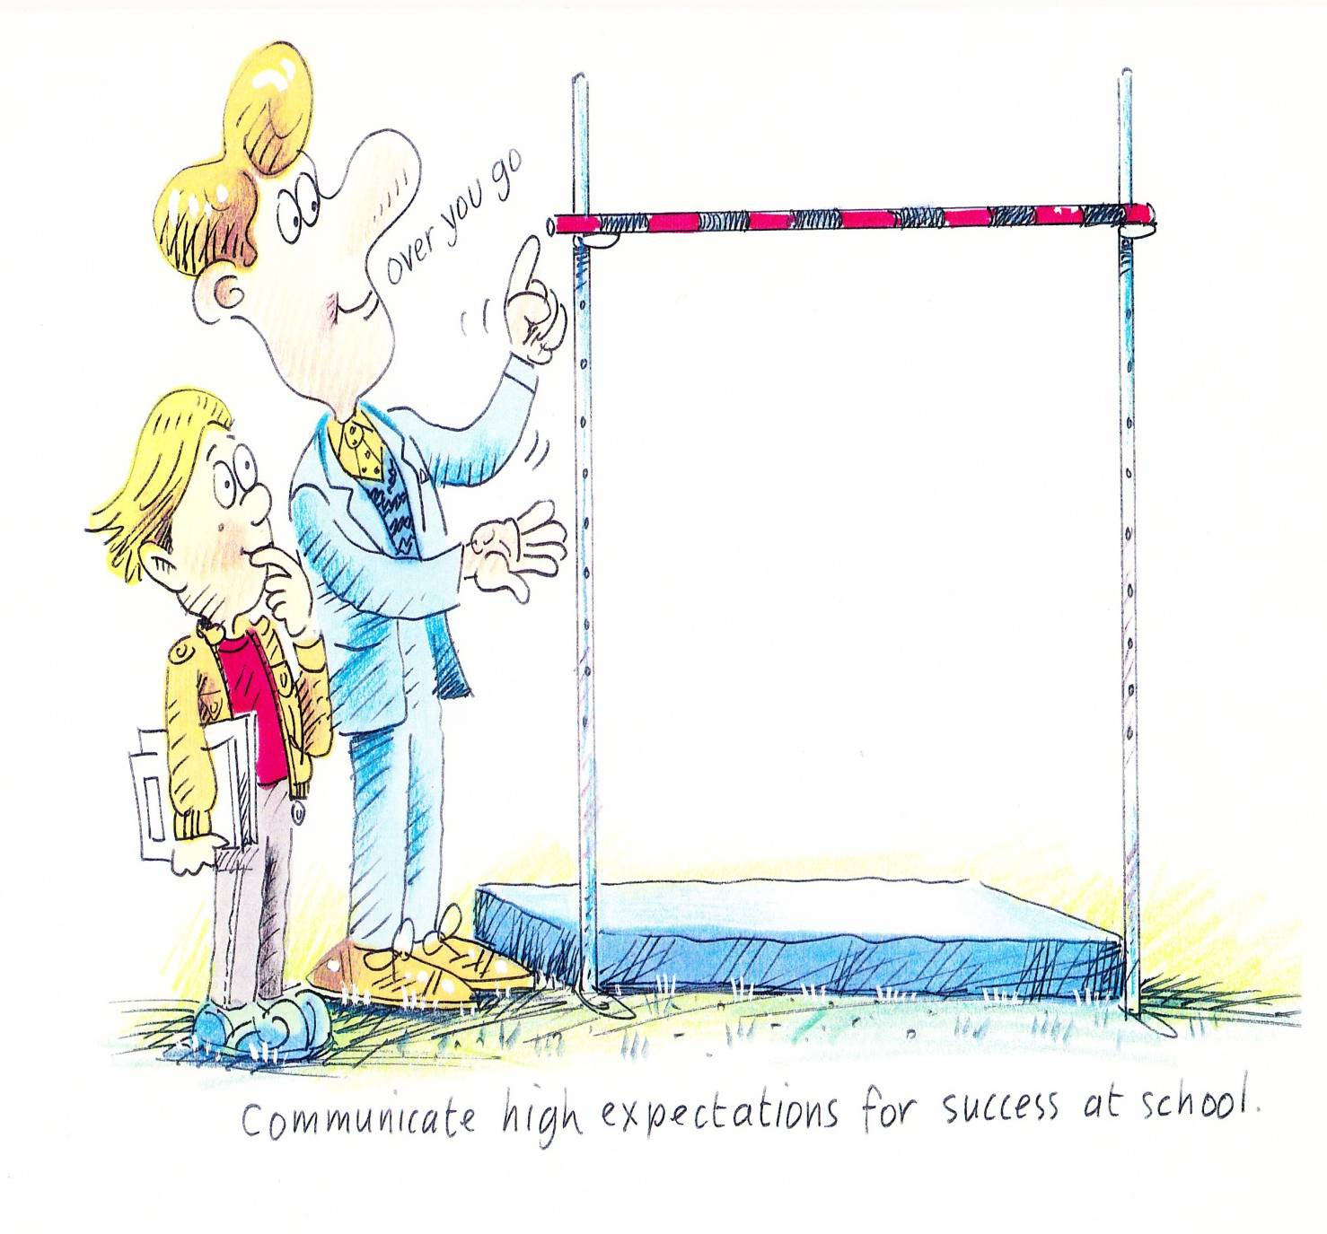
High and realistic expectations for success

Slide 9
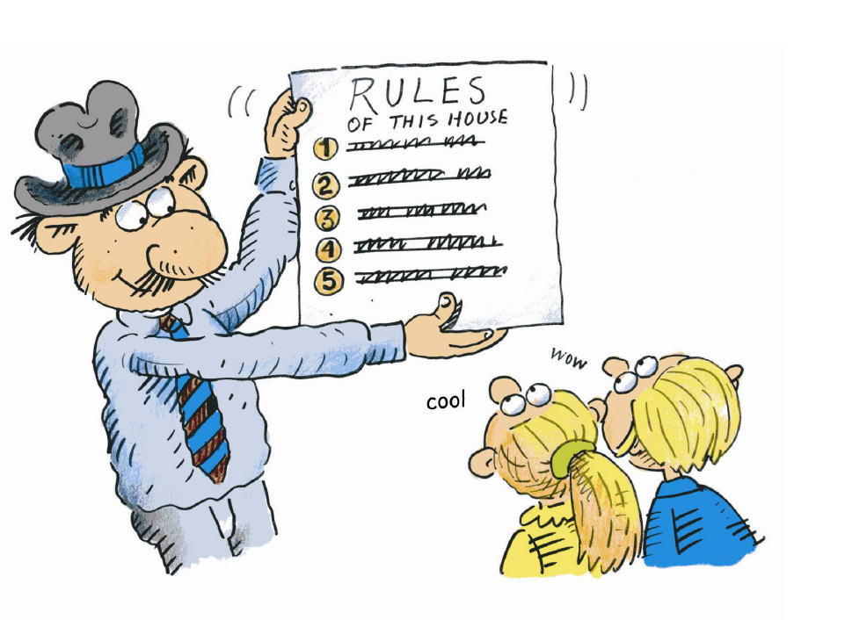
High expectations for behaviour

Slide 10
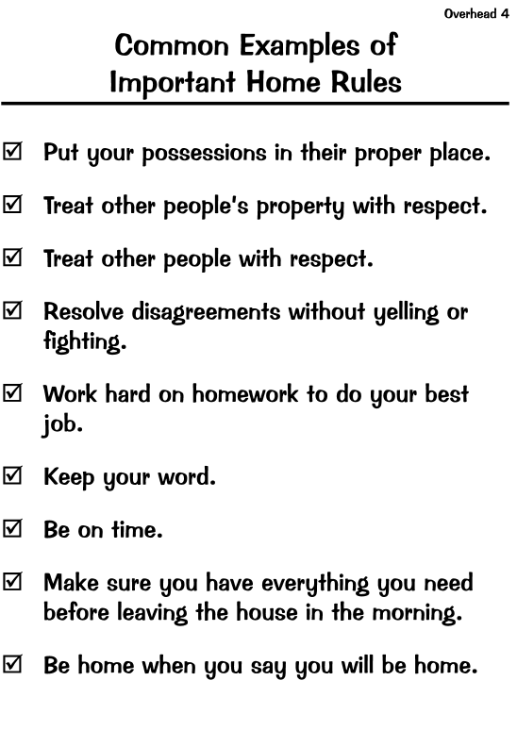

Slide 11
GROUP DISCUSSION
GATHER TOGETHER IN GROUPS BASED ON THE AGE OF YOUR CHILD
5-7 8-10 11-13
CREATE A SHORT LIST (3-5) OF IMPORTANT RULES FOR HOME
WE WILL HEAR EACH OTHERS’ RULES
TRY TO STICK TO THE GUIDELINES ON THE NEXT PAGE

Slide 12
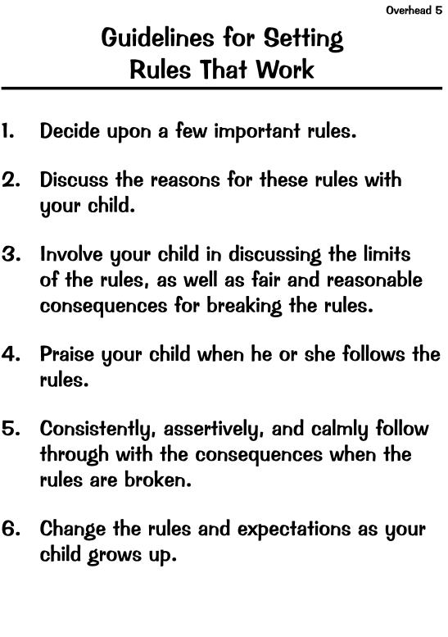

Slide 13
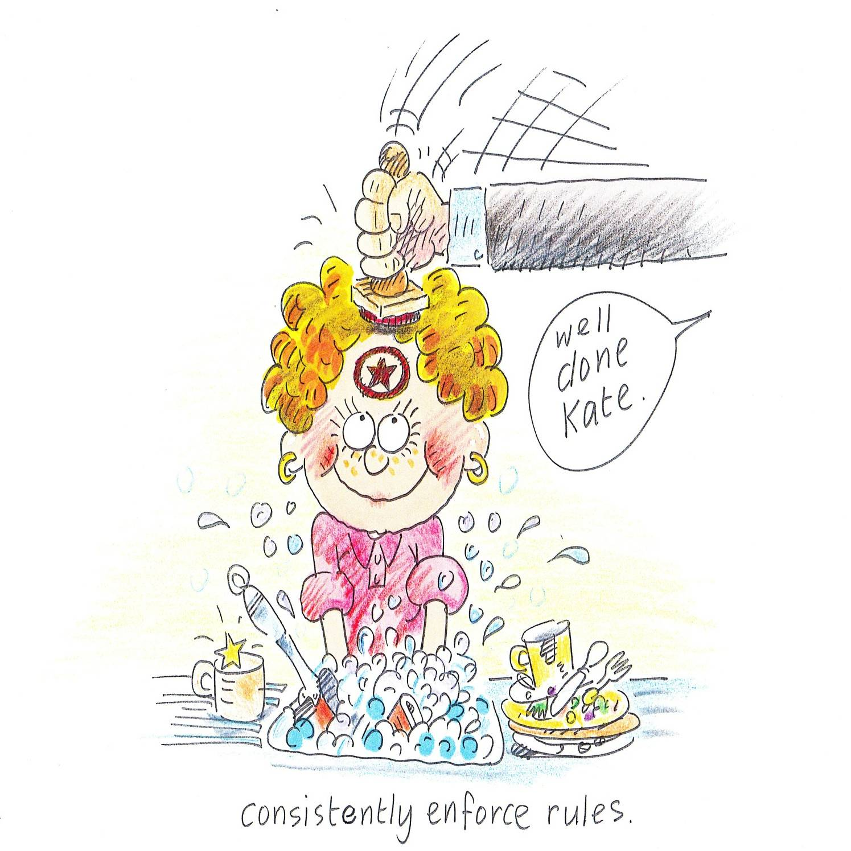
Be consistent and persistent

Slide 14
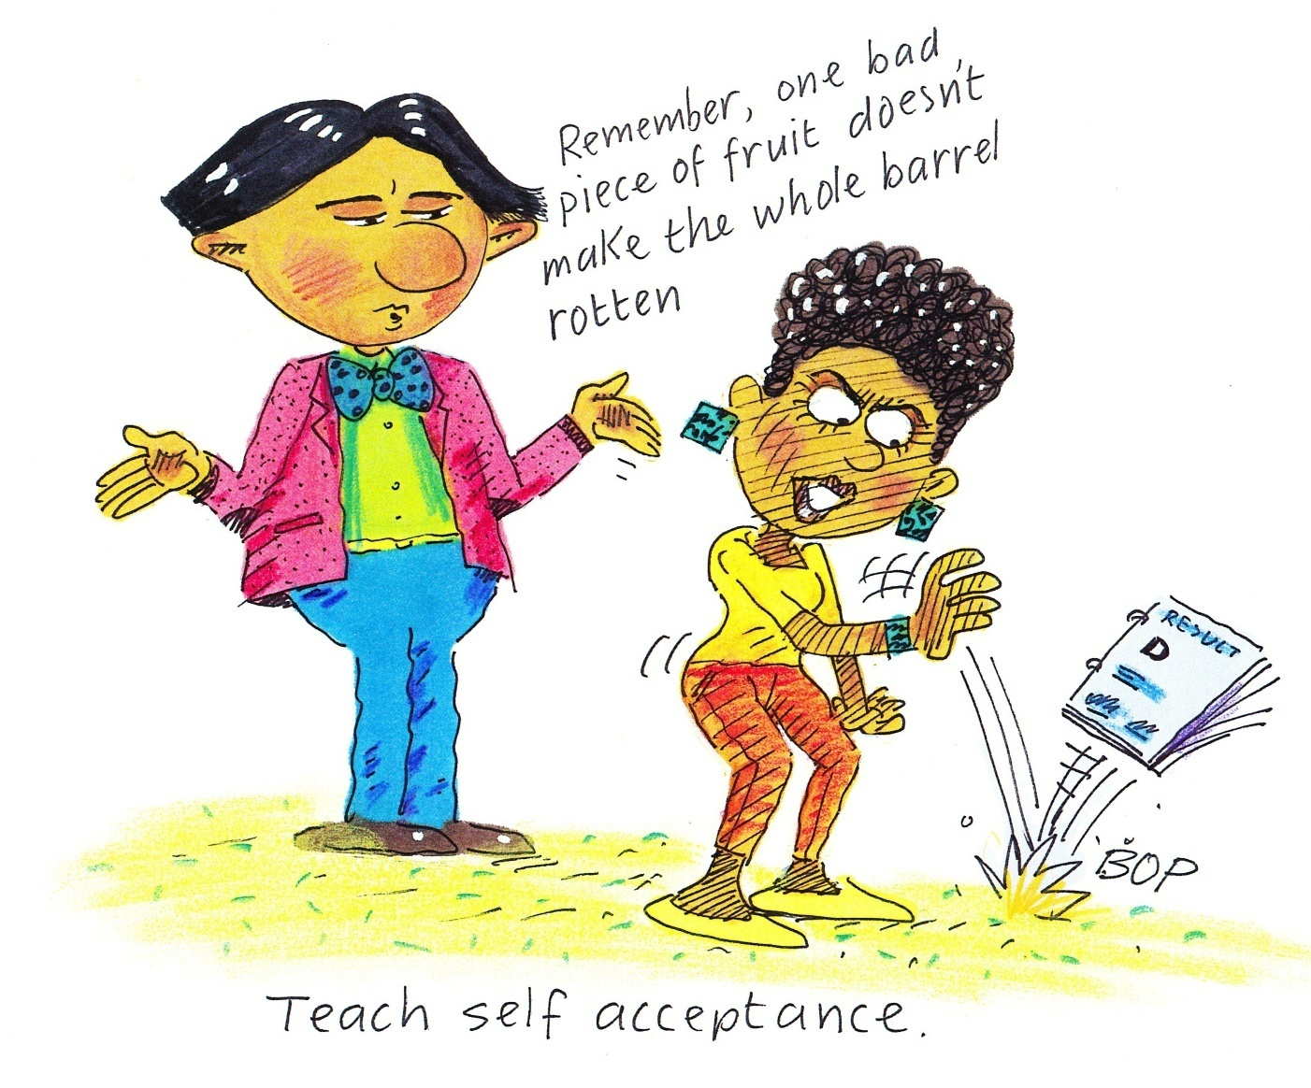
TEACH CHILDREN TO ACCEPT THEMSELVES

Slide 15
Parent ‘Homework’ – Rules that work
If you would like, take a copy of ‘Guidelines for Setting Rules that Work’

Slide 16
Be Involved in your children’s education
Module 6

Slide 17
Supportive Person at home
Notes:
Ask participants to share a positive outcome they have observed after taking time to be involved.
Discuss with the person next to you any specific problems you have with being involved in your child school life; e.g short on time, working parent.
Do you have a solution or something that works in your family?
In advance, plan several short periods throughout the week to discuss school with your children or visit the school.
Arrange a friend or relative to serve as that supportive person if you are unable.
Show enthusiasm for what your child is learning, children become more interested and engaged in learning if those around them are excited and interested in the learning as well.
Come to

Slide 18
Ways to get involved at ehps
Attend the ‘Meet the Teacher’ session at the start of a new school year
Attend parent teacher interviews
Get involved in the classroom for Literacy or Maths Groups
Read the school newsletter regularly, subscribing to enews
Reading notes and returning them promptly to show a value of the event
Attend school events and weekly school assemblies
Help children to be organised by knowing what they need on each day and encouraging them to get it organised
Volunteering at the canteen, kiss and ride
Participate in the P & C or the P & C Auxilary
Check Edmodo accounts
Regular contact with their teacher if required via email, notes, phone calls or in person
Participate and engage in school fundraisers, Fireworks Night

Slide 19
Ways to get involved with your children at home
Ask your children about their day, lead the question by asking “tell me five good things that happened today?”
Ask them about any school events that occurred that day
Ask them if they borrowed from the Library and what book
Ask them if they had Science and what they did during the lesson
Read with them and discuss the story together
Discuss with them any upcoming school events and write it on a calendar together
Help your children to prepare for news presentations/speeches

Slide 20
Homework
Where possible and if time permits encourage the completion of homework.

Slide 21
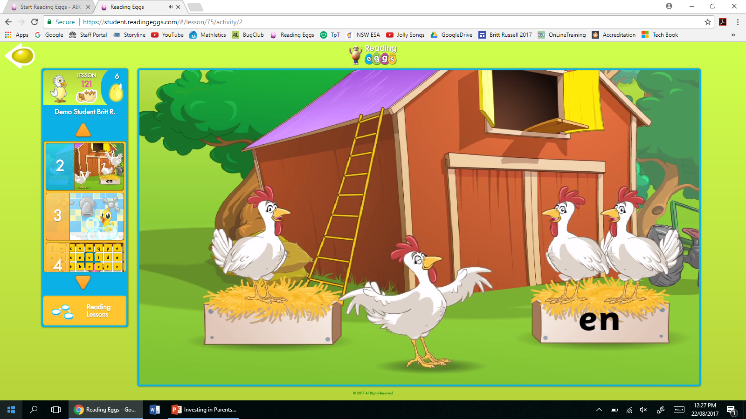
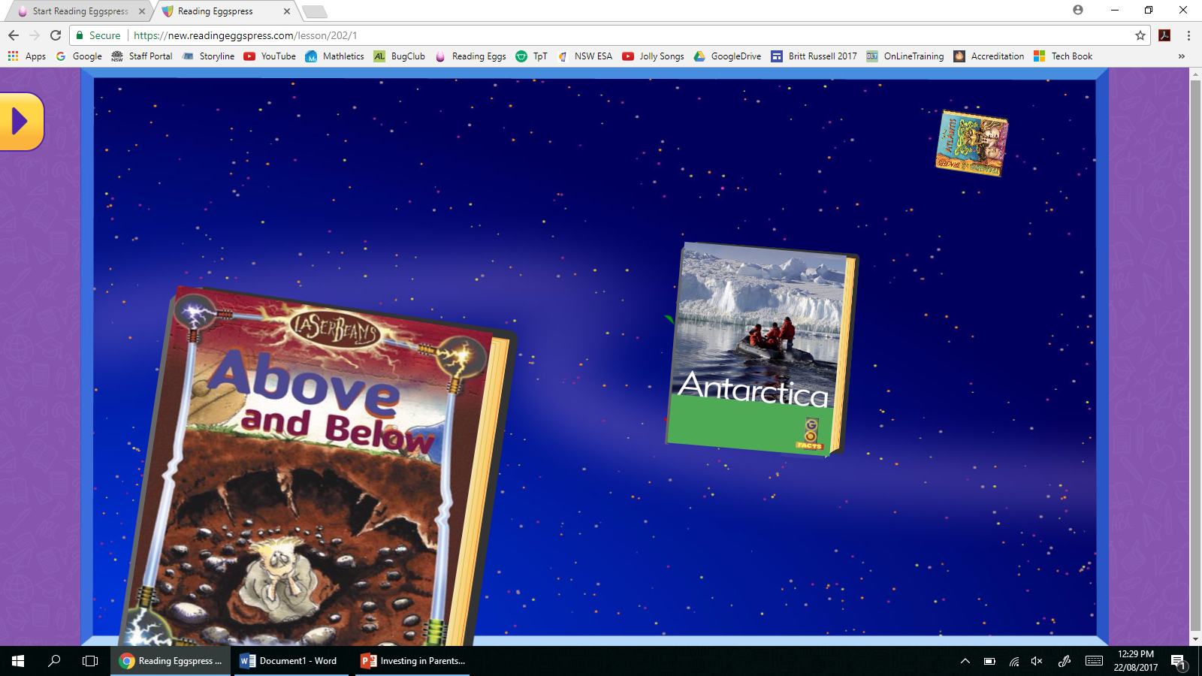
What you can do at home
Our school subscribes to Reading Eggs/Reading Eggspress

Slide 22
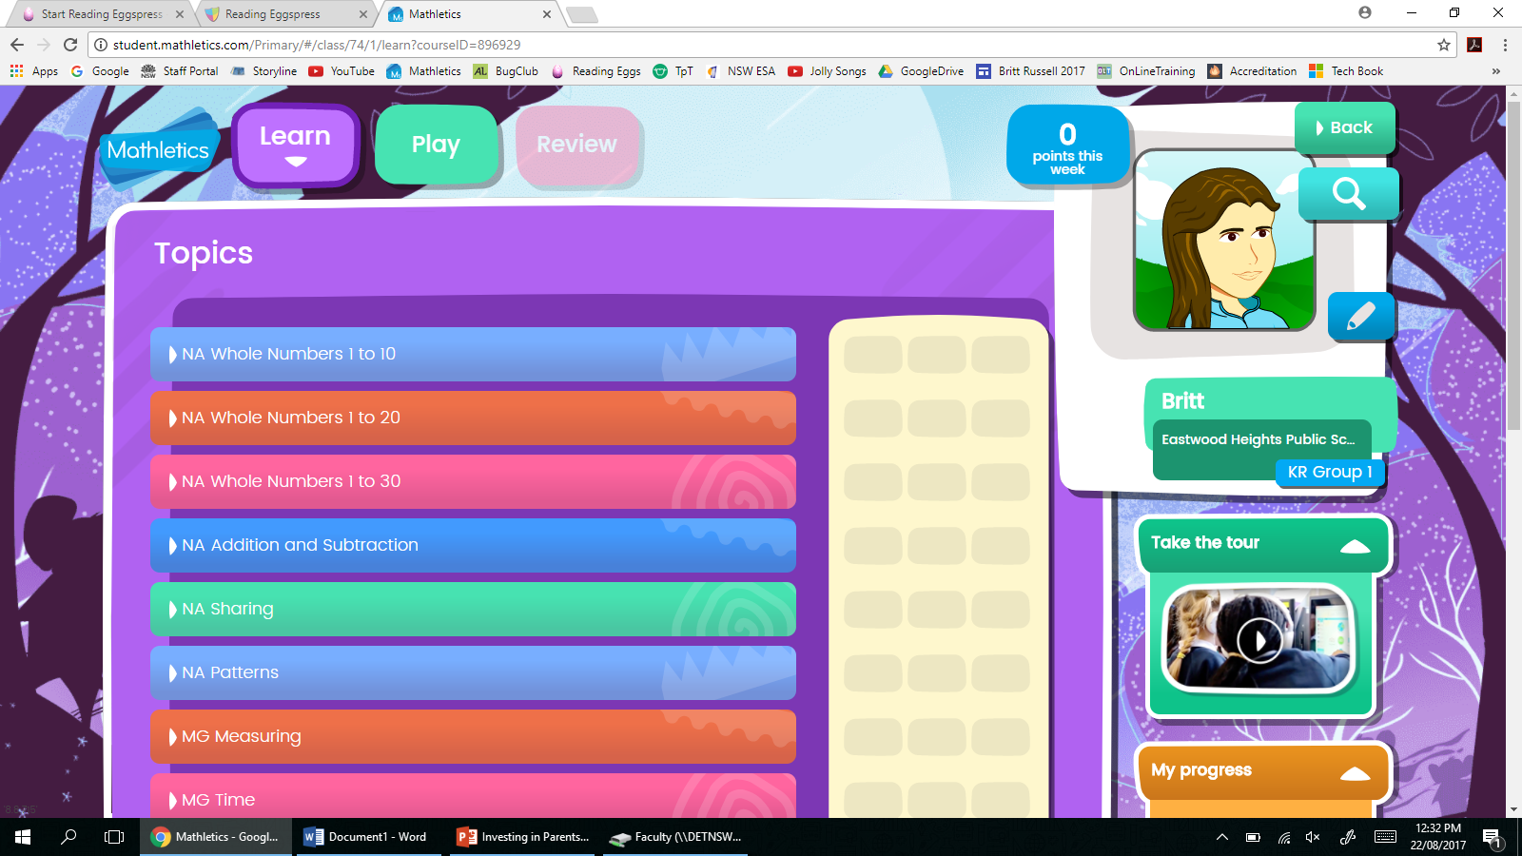
What you can do at home
Our school subscribes to Mathletics

Slide 23
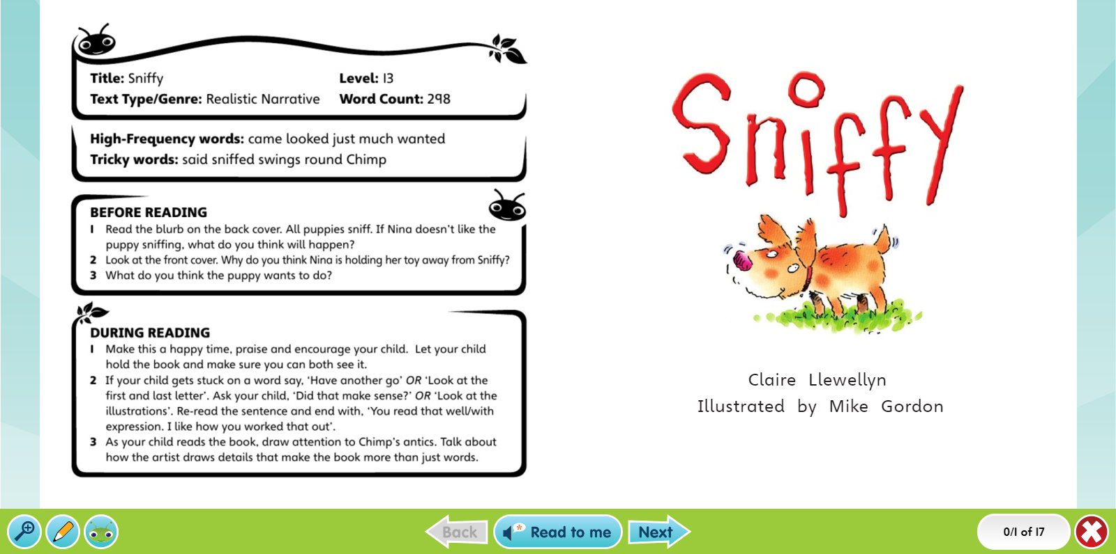
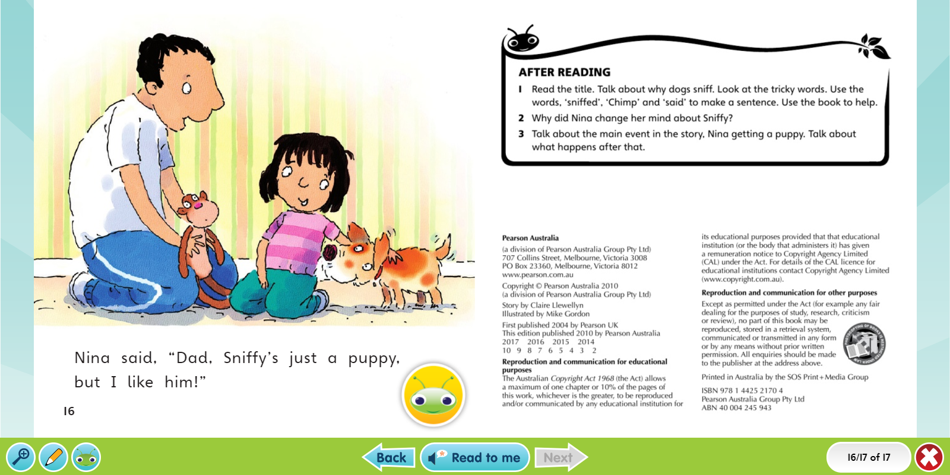
What you can do at home
K-2 children have access to Bug Club (digital books) and Home Readers (physical books)

Slide 24
Working towards independence!

Slide 25
Thank you!

